Slide 1
Kyle Simmons: Project History
February 2023
2023 Presentation. This document is the product of many hours of creative and technical efforts of Kyle Simmons. As such, all rights to copyrighted, trademarked, and patentable information is reserved.

Slide 2
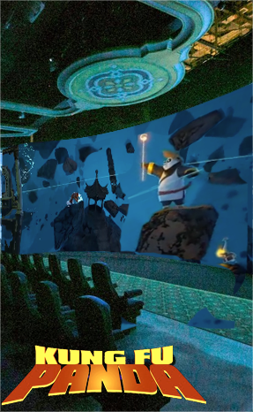
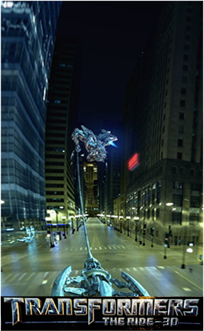
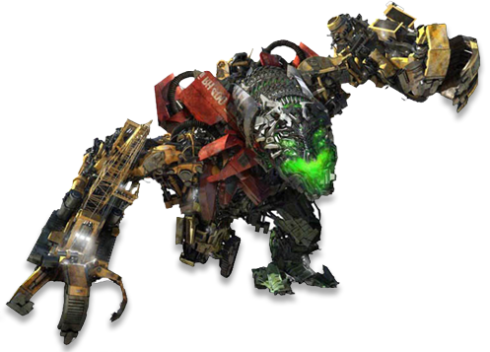
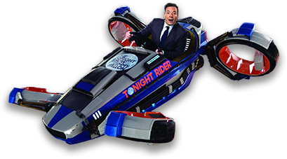
A show programmer must be able to answer some interest technical questions…
How much water should hit you if you drive a flying car into the East River?
I created these experiences by animating various motion bases.
How does your body react to being blown into the spirit realm by a magic hammer?
What does it feel like to be eaten by a giant robot?
Notes:
What does it actually feel like to be eaten by a giant robot?
[Transformers video]
How would your body respond to being blown into the spirit realm?
[KFP video]
And how much water spray would hit you if you drove head first into the East River?
[Jimmy Fallon]
These are the questions asked and answered by a Show Programmer.

Slide 3
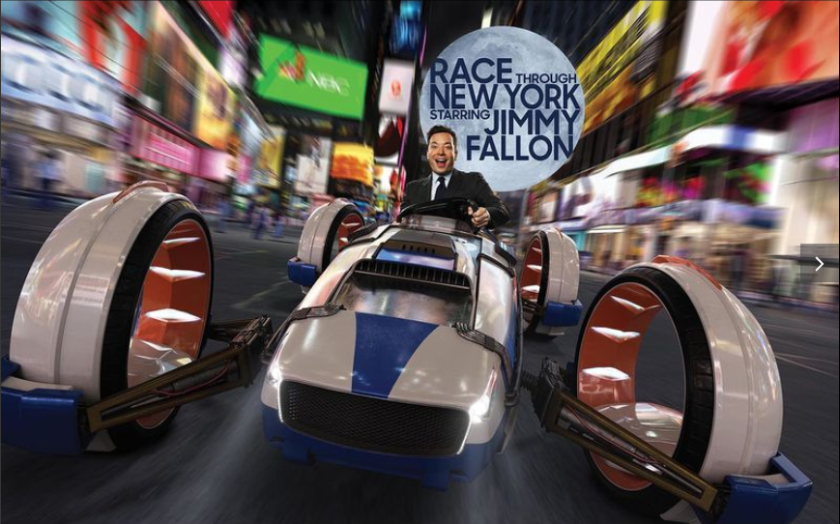
Show Programming
Animating A Ride Vehicle
So, how do you animate a ride vehicle?
Show programmers use animation software
Maya for vehicle motion
MotionBuilder for animated figures (animatronics)
Unreal for visualizing real-time interaction.
In this video, the 72 seat theater is driven by massive crank arms. A digital twin of the theater floor is first animated. Then the motion of the crank arms is recorded. That becomes the control data that drives the actual hardware.
BUT!!!
… Ride & Show Programming is a lot more than just animating a 3D model.
Notes:
So you might be wondering, how do you animate a ride vehicle?
NOTES:
- Define Pitch, Roll, Heave, & Yaw
Vehicle motion
Show Action Equipment
Special Effects Timing
Show Sequencing
Coaster timing
If you have a vehicle or any equipment that has to move to a particular timing and rhythm, the show programmer programs that timing.
The Creative Director writes the story, the Attraction Designer creates the space, the engineers design the ride vehicle. The Show Programmer tells the story with the motion of the vehicle through that attraction space. We are integral to the process.

Slide 4
Show Programming
Motion Analysis
Transformers: 3D
Show programming is about story-telling through motion design, timing, & sequencing.
Notes:
Timing of show scenes and the elements throughout the attraction
Start and end cues of:
SAE & Figures
Special Effects
Lighting
Audio
Most timing is triggered by the start of an event, a scene, or a ride sensor
Delay times between the trigger and the actual cue are require finessing
We also synchronize events like an animated figures movements with audio

Slide 5
Show Programming
Clearance Study
Harry Potter & The Forbidden Journey
It’s about story-telling, thrill-making, engineering safety, and collision avoidance.
Notes:
Timing of show scenes and the elements throughout the attraction
Start and end cues of:
SAE & Figures
Special Effects
Lighting
Audio
Most timing is triggered by the start of an event, a scene, or a ride sensor
Delay times between the trigger and the actual cue are require finessing
We also synchronize events like an animated figures movements with audio

Slide 6
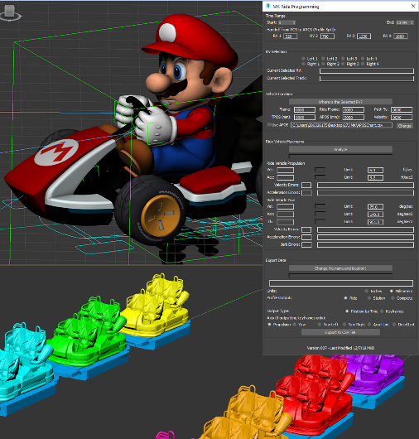
Show Programming
Stewart Platform (Unreal)
Mario Kart: Bowser’s Challenge
(Unreal)
Show programming is about developing the tools for immersive experiences...
Notes:
What is SAE?
Anything that moves in the ride box that…
Isn’t a vehicle
Has an animation profile
Isn’t an animated figure
Design considerations:
Creative development
Tight integration with ride vehicle
Wide variety of programming systems
Engineering factors and physics of motion.

Slide 7
Show Programming
Motion Based Media Effects
The Amazing Adventures of Spider-Man
and
Skull Island:
Reign of Kong
… and being an integral part of developing immersive effects, such as squinching.
Notes:
What is SAE?
Anything that moves in the ride box that…
Isn’t a vehicle
Has an animation profile
Isn’t an animated figure
Design considerations:
Creative development
Tight integration with ride vehicle
Wide variety of programming systems
Engineering factors and physics of motion.

Slide 8
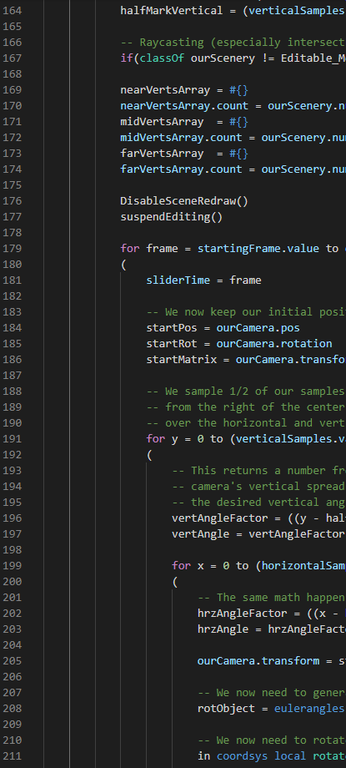
Show Programming
Tools Scripting
Viewshed Tool
Creative Directors and designers can visualize what show set elements are visible from the guest perspective
Differentiates show elements that are clearly visible versus elements that are always in the periphery
We build digital twins to simulate the guest experience…
Notes:
During early phases of attraction design, it’s valuable to see heat maps of the show set design to highlight where the guests’ line of sight will be focused. This demonstrates the most likely locations that park guests will be looking during a ride, and the duration that their attention is focused. This allows attraction designers to place meaningful visuals in the highest impact locations, as well as areas to reduce costs by minimizing expensive decorations and prop-making.
Heat maps were generated by projecting rays from the virtual camera mounted from the guests perspective on the KUKA-robot toolpoint. The duration of visibility, distance from the camera, and minimum angle from center were stored as Red, Green, and Blue vertex color values, respectively, on the show set model surface.

Slide 9
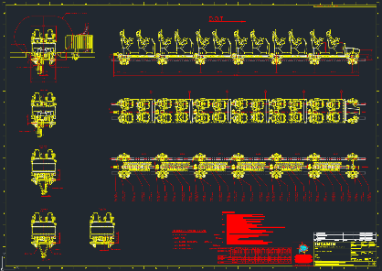
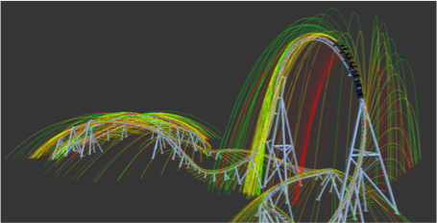
Ride & Show Animation
Roller Coaster Animation
FOD Trajectory Study
… as well as digital twins to analyze the ride system performance.
Notes:
The development of roller coasters includes design of the surrounding land area and buildings. One risk factor of coasters is the possibility of objects being ejected from guest pockets or hands and damaging surrounding structures, or impacting guests. A trajectory study of typical objects ejected from roller coasters allows designers to design walking paths to avoid potential landing zones, and included themed coverage when walking paths must pass through an impact zone.
This requires an accurate digital twin of the roller coaster based on precise models of the coaster vehicle, track, and engineering data that gives accurate velocity information of the coaster along the entire length of the track. This digital twin is also used to simulate the control of the vehicle by having the PLC link to Unreal directly, providing both virtual testing of the PLC controls as well as the show performance.

Slide 10
Ride & Show Animation
Coaster Simulator (Unreal)
RIP RIDE ROCKET
(Unreal)
We use VR tools, such as Unreal, and flexible motion systems to test pilot our shows…
Notes:
What is SAE?
Anything that moves in the ride box that…
Isn’t a vehicle
Has an animation profile
Isn’t an animated figure
Design considerations:
Creative development
Tight integration with ride vehicle
Wide variety of programming systems
Engineering factors and physics of motion.

Slide 11
Ride & Show Animation
Autonomously Guided Vehicles
… and to simulate autonomous vehicle performance.
Notes:
Autonomously guided vehicles exist in several forms at several parks. Some of the more basic forms, such as Luigi’s Rollickin’ Roadsters at Disney’s California Adventure include a pre-programmed path with little response to surrounding input. Other attractions, such as Universal’s Skull Island: Reign of Kong and Fast & Furious: Supercharged, use preprogrammed paths with various levels of responses to surrounding input. In all of these attractions, the AGVs come to a complete stop at a pre-determined load station.
An innovative attraction we were developing used AGVs moving in a complex carousel motion in a continuous motion. The attraction never stops moving, even as guests exit and enter the vehicles. New vehicles are introduced the carousel pattern and then exit 4 minutes later. This requires constant adjustment to the vehicle motion paths.
Further complicating the concept is the notion of what to do when a vehicle must exit early (e.g. due to a Code V), or if a vehicle breaks down and comes to a stop. Rather than requiring the entire attraction to stop, using AI and autonomous pathfinding solutions would allow the other vehicles to adapt to the new obstacle, and even clear a path for an AGV “tow truck” to come in, hook up to the dead vehicle and move it to safety.

Slide 12
Abstract
On a dark ride such as Harry Potter & the Forbidden Journey™, it is often useful to see the total space a ride vehicle occupies as one single object model. In this example, the ride vehicle has 6-DOF motion and can be in almost any position and orientation within a 4 meter radius of the transport.
A 4D extrusion (green above) represents all of the space that must be clear of the show set and facilities (grey) for the vehicle to make safe passage for the duration of the show. Objects that intrude on this space must either be cut away (show set) or animated to move in sync with the vehicle (SAE) to ensure proper clearance.
2023 Presentation. This document is the product of many hours of creative and technical efforts of Kyle Simmons. As such, all rights to copyrighted, trademarked, and patentable information is reserved.

Slide 13
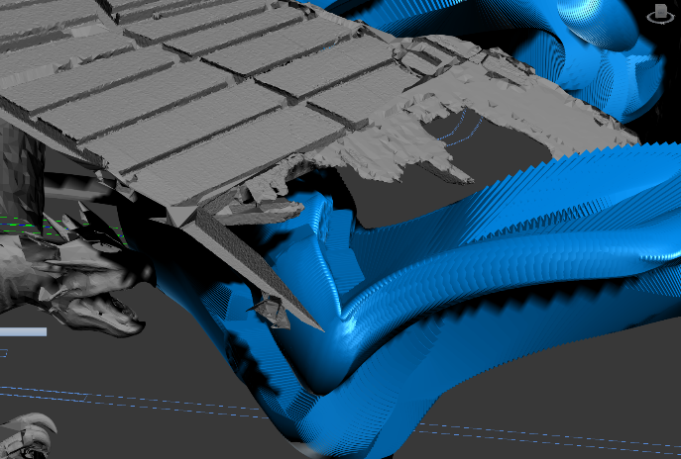
Swept Path Model
Brute Force Solution
In the past, a brute force solution was used to generate a representation of this swept path.
A clone of the vehicle model and Profile Inspection Gauge (PIG) would be generated at a regular sample rate throughout the animation of the ride path (Blue). The clearance of this 4D space claim would be visually compared against the 3D scan of the attraction show set, facilities, and show action equipment (Grey).
2023 Presentation. This document is the product of many hours of creative and technical efforts of Kyle Simmons. As such, all rights to copyrighted, trademarked, and patentable information is reserved.

Slide 14
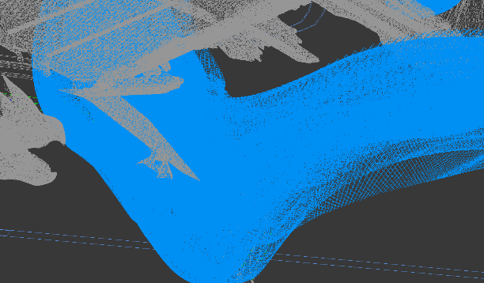
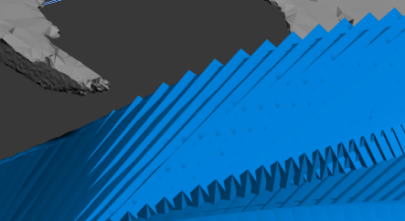
Swept Path Model
Brute Force Solution
Problems with this solution include:
Each sample is still a distinct mesh
Unnecessarily high poly count
Unnecessarily large files
Procedural interference checking must consider each sample mesh
Even at high sample rates, there is some amount of 3D aliasing.
2023 Presentation. This document is the product of many hours of creative and technical efforts of Kyle Simmons. As such, all rights to copyrighted, trademarked, and patentable information is reserved.

Slide 15
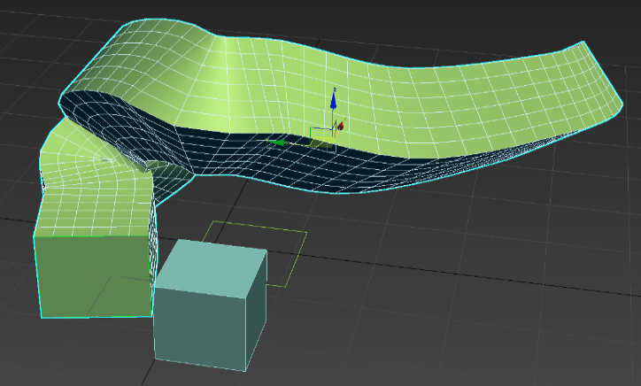
Swept Path Model
Ideal Solution
Output:
A continuous smooth mesh surface with no internal polygons.
Topology is clean and optimized for procedural interference checks
2023 Presentation. This document is the product of many hours of creative and technical efforts of Kyle Simmons. As such, all rights to copyrighted, trademarked, and patentable information is reserved.

Slide 16
Swept Path Model
Off the Shelf Alternatives
Boolean Union (3DS Max):
Both 3DS Max and Maya had problems with rats nest topology that would annihilate the mesh before completing the sweep.
Autodesk AutoTurn
An off the shelf tool used for swept path analysis of street vehicles. This option only works for predefined cars and trucks in the Autodesk library, with no options for vehicles that reconfigure their shape during motion.
NEITHER OF THESE COTS ALTERNATIVES IS SUITABLE FOR THE TASK.
2023 Presentation. This document is the product of many hours of creative and technical efforts of Kyle Simmons. As such, all rights to copyrighted, trademarked, and patentable information is reserved.

Slide 17
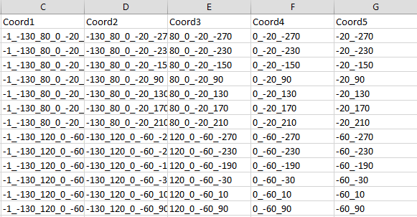
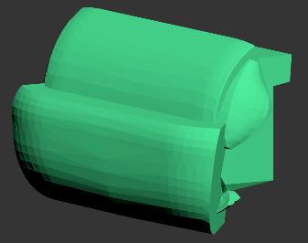
Swept Path Model
Algorithm
Input:
The mesh being traced is called the "brush".
The brush must be a water-tight mesh. (No border edges).
The brush must be entirely triangulated. (All polygons are triangles).
All objects have one and only one mesh element.
An “animation array” of transformation matrices representing the position and orientation of the mesh at regular intervals.
2023 Presentation. This document is the product of many hours of creative and technical efforts of Kyle Simmons. As such, all rights to copyrighted, trademarked, and patentable information is reserved.

Slide 18
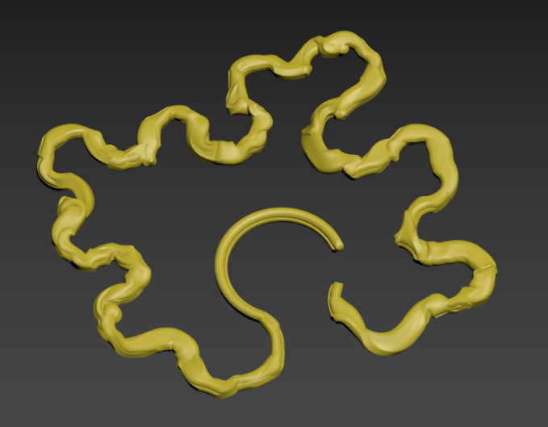
Swept Path Model
Algorithm
Output:
A smooth mesh (called the stroke) representing the full ride envelop
Ride envelop represents full motion of the vehicle, including:
Translation
Rotation
Switch back
No internal polygons within the outer mesh envelop
No overlapping, folded, or facing polygons
No rats nest topology
2023 Presentation. This document is the product of many hours of creative and technical efforts of Kyle Simmons. As such, all rights to copyrighted, trademarked, and patentable information is reserved.

Slide 19
Swept Path Model
Algorithm
Process:
Sample the brush mesh at regular time intervals (with updated position and orientation).
Calculate the projection of each vertex against the same vertex on the previous time sample.
If the projection produces a positive value, generate a prism between the two polygons.
Handle degenerate and self-intersecting polygons as necessary.
For each set of new leading edge prisms, perform a Boolean union of the set to produce a leading edge stroke.
Once the complete set of leading edge strokes are created, merge them using the most efficient patter available.
E.g. merge in iterative pairs.
2023 Presentation. This document is the product of many hours of creative and technical efforts of Kyle Simmons. As such, all rights to copyrighted, trademarked, and patentable information is reserved.

Slide 20
Swept Path Model
Algorithm
Process:
2023 Presentation. This document is the product of many hours of creative and technical efforts of Kyle Simmons. As such, all rights to copyrighted, trademarked, and patentable information is reserved.

Slide 21
Swept Path Model
Algorithm
Pseudo-code:
meshCurrent[]; // the array of vertex positions of the brush mesh at the current time sample
// initialize to the first time sample in the animation array
meshPrevious[]; // the array of vertex position of the brush mesh at the previous time sample
// initialize to the first time sample in the animation array
leadingEdgeMesh[]; // an array of structs describing the prisms generated in this step
For each element in the animation array
update meshCurrent[] to the vertex positions of the next sample in the animation sequence
for each triangle in the brush mesh
calculate vertex displacement = ( meshCurrent[i] – meshPrevious[i] )
if the projection of the triangle normal onto the displacement vector is greater than 0
generate a prism from the current and previous triangles
Append the prism shape in an array of structs describing the model
meshPrevious = meshCurrent
2023 Presentation. This document is the product of many hours of creative and technical efforts of Kyle Simmons. As such, all rights to copyrighted, trademarked, and patentable information is reserved.

Slide 22
Swept Path Model
Algorithm
Pseudo-code:
cgal_LEStroke[]; // an array of references to the leading edge stroke meshes in CGAL format
// Defined on this slide for clarity. Would normally be defined outside the for loop.
Generate a new empty CGAL mesh for the leading edge stroke
Append the new mesh to the cgal_LEStroke[] array
For each struct in the leadingEdgeMesh[] array
cgal_LEMesh = generate a new CGAL mesh from the struct
cgal_LEStroke[i] = cgal_LEStroke[i] + cgal_LEMesh; // CGAL union of prism meshes
// end for-loop for animation array
After the stroke component is created, it is unioned to the total mesh.
After the mesh has been refined, it is optimized.
2023 Presentation. This document is the product of many hours of creative and technical efforts of Kyle Simmons. As such, all rights to copyrighted, trademarked, and patentable information is reserved.

Slide 23
Swept Path Model
Algorithm
Pseudo-code:
cgal_mesh cgal_SweptPathStroke; // a CGAL mesh representing the final swept path model
// Defined on this slide for clarity.
int meshCount = cgal_LEStroke.count(); // total count of leading edge stroke mesh objects
int offset = 1; // the offset jump between branches
do{
if (meshCount.isOdd())
cgal_LEStroke[offset*(meshCount-1)] += cgal_LEStroke[offset*meshCount]; // combine last 2 mesh
meshCount -= 1;
for ( int i = 0; i < meshCount; i++)
cgal_LEStroke[i * offset] += cgal_LEStroke[(i+1)*offset]; // combine meshes in binary tree
offset *= 2;
meshCount /= 2;
} while (meshCount > 1);
2023 Presentation. This document is the product of many hours of creative and technical efforts of Kyle Simmons. As such, all rights to copyrighted, trademarked, and patentable information is reserved.

Slide 24
Swept Path Model
Algorithm
Pseudo-code:
cgal_SweptPathStroke = cgal_LEStroke[0] // Assign final Boolean union mesh to output
return cgal_SweptPathStroke.optimize(); // return after optimizing the mesh
2023 Presentation. This document is the product of many hours of creative and technical efforts of Kyle Simmons. As such, all rights to copyrighted, trademarked, and patentable information is reserved.

Slide 25
Swept Path Model
Algorithm
Edge cases:
Special code was included to handle the following conditions:
Degenerate meshes that included 0-length edges, and 0-area polygons.
Smearing, where extremely thin prisms were generated from polygons that moved nearly sideways.
Self-intersecting polygons, usually caused by polygons close the object’s center of rotation.
Boolean unions were handled in binary tree fashion to reduce the number of comparisons.
The performance improvement was mostly from deferring large calculations to the end of the process.
2023 Presentation. This document is the product of many hours of creative and technical efforts of Kyle Simmons. As such, all rights to copyrighted, trademarked, and patentable information is reserved.

Slide 26
Swept Path Model
Algorithm
Optimization:
There are several items in the queue to optimize the way to tool handles:
Improved performance is key. It still takes an hour to do a basic sweep.
Real-time performance would be ideal. This would require segmenting the motion path somehow and only updating the section that is being edited.
Improved mesh topology. Occasionally we still get rats nest topology.
This annihilates the mesh during subsequent unions.
Vertex meta-data to store data at penetration points.
Time
Speed
Direction of impact
Still working on getting PyMesh to work as a python wrapper for CGAL.
This would allow the tool to be called directly from inside 3DS Max, Maya, Motionbuilder, Unreal, Unity, etc.
2023 Presentation. This document is the product of many hours of creative and technical efforts of Kyle Simmons. As such, all rights to copyrighted, trademarked, and patentable information is reserved.

Slide 27
Swept Path Model
Algorithm
Conclusion:
The theory behind the tool works. The reduction in poly count from the brute force method is between 70% – 95%, depending on the application, with only a 50% increase in processing time.
In its current state, it is more complex to use than the brute force solution. As such, some people at Creative don’t like to use it. I am still in the process of making it more user friendly, and more stable.
2023 Presentation. This document is the product of many hours of creative and technical efforts of Kyle Simmons. As such, all rights to copyrighted, trademarked, and patentable information is reserved.

Slide 28
THANKS!
2020 Presentation. This document is the product of many hours of creative and technical efforts of Kyle Simmons. As such, all rights to copyrighted, trademarked, and patentable information is reserved.

